Slide 1
Basic RISC CPU (BRC) Verification
By Spencer Hernandez

Slide 2
Introduction
In this report, we aim to verify that the instruction set of the BRC we have been building this semester is fully functional. This will be done by simulating four assembly programs in a Java-based simulator, as well as in Modelsim, and verifying that the final state of each machine matches. Once we do this, we will know that the instructions perform as we intend them to, so the CPU will be operational.

Slide 3
Add Tests (add)
This program verifies the la, add, st, ld, and stop instructions by loading 2 different numbers in different registers, adding them, storing them, and then loading them into a new register

Slide 4
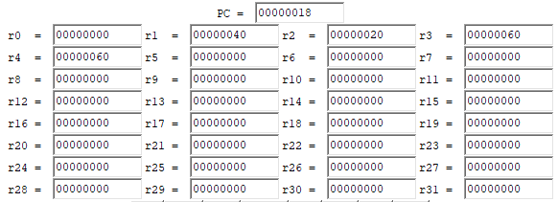
Add Tests (add)
Java-based simulator results
Modelsim results

Slide 5
ALU Tests (alu_tests)
This program verifies the br, addi, and, or, sub, ori, nop, not, shr, shc, shl, shra, and andi instructions.
Registers r1 through r15 are filled with their corresponding values (ie: r6 gets loaded with 6)
Registers r16 through r23 are filled with strings that mostly contain F to see that the bits are being properly changed
Registers r24 throughr31 are filled with their corresponding values (ie: r29 gets loaded with 29)

Slide 6
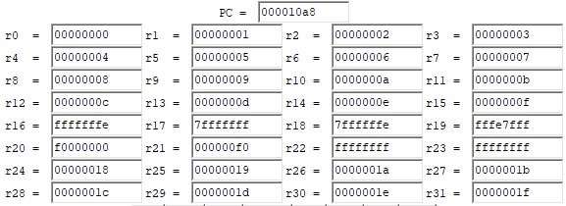
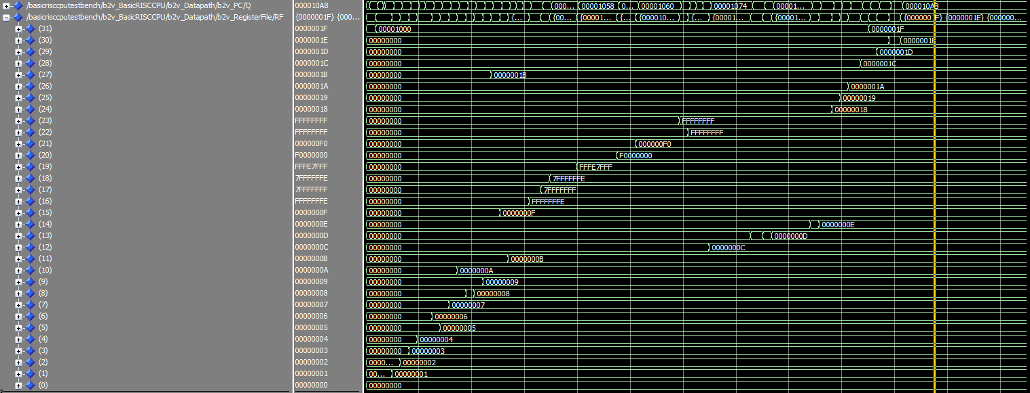
ALU Tests (alu_tests)
Java-based simulator results
Modelsim results

Slide 7
Branch Tests (branch_tests)
This program verifies the brl instruction.
Several addresses are loaded into registers r1 through r11, and then branching instructions are used to act as loops and increment values in registers.
Branch and link addresses are loaded into registers r12 through r16. The tester must monitor the statements; executed to confirm that control is properly passed based on the register values used.
r20 is loaded with the address of stop

Slide 8
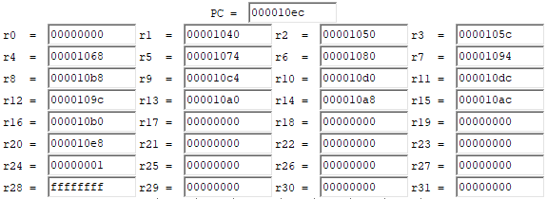
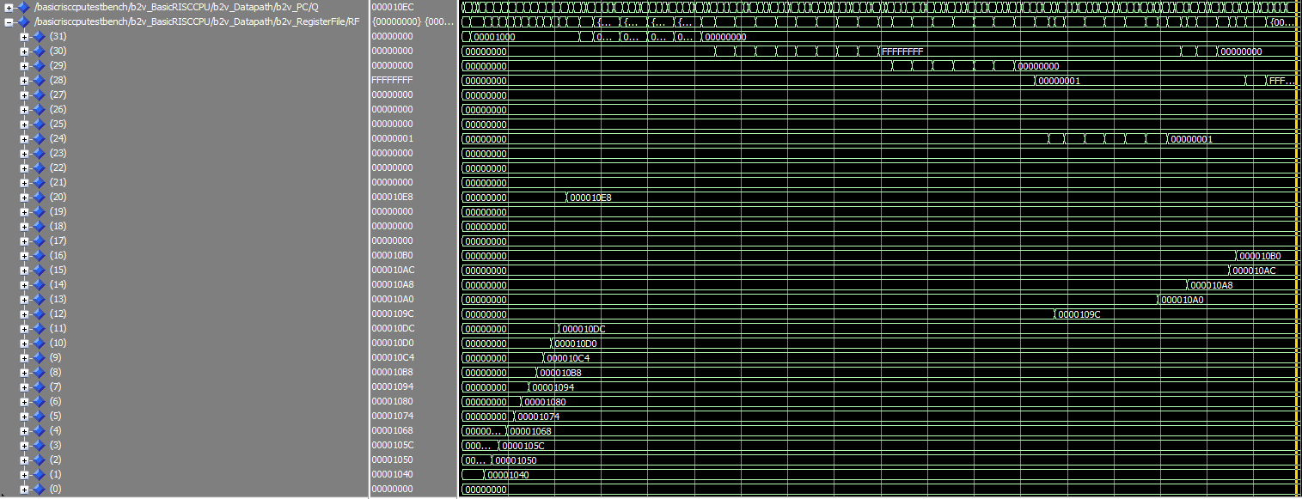
Branch Tests (branch_tests)
Java-based simulator results
Modelsim results

Slide 9
Load Store Tests (load_store_tests)
This program verifies the str, ldr, and lar instructions.
r0 loaded with 8000 (hex)
r1 through r3 are loaded with 1s, r4 through r7 loaded with 2s, r8 through r11 filled with 3s, r12 through r15 loaded with 4s, r16 through r19 are loaded with 5s, r20 through r23 loaded with 6s, r24 through r27 filled with 7s, r28 through r31 loaded with 8s

Slide 10
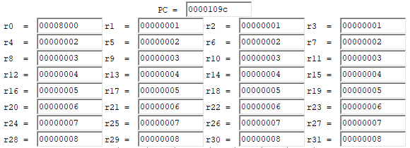
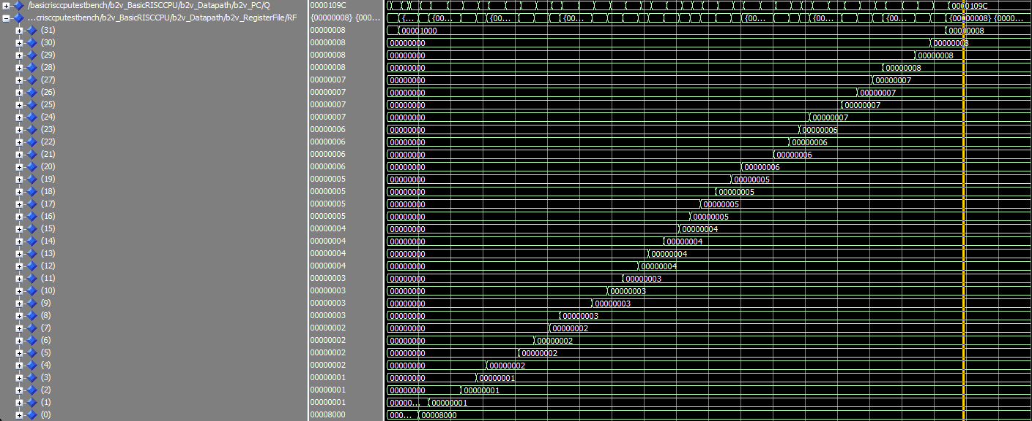
Load Store Tests (load_store_tests)
Java-based simulator results
Modelsim results

Slide 11
Conclusion
After successfully simulating the tests in the Java-based simulator and running the tests in Modelsim, we can see that for each test, the final state (the values held in all the registers) of each simulation matches. Therefore, the entirety of the instruction set of the CPU is functioning properly, and we can conclude that the functionality of this Basic RISC CPU is verified.

